Slide 1
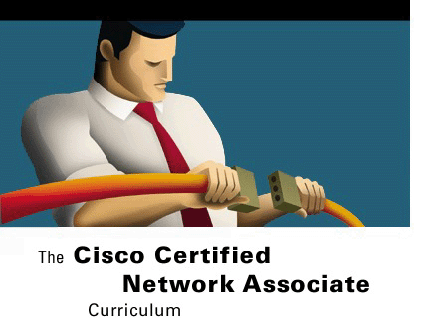



CONFIGURING
A ROUTER
Routing and Router Basics
Version 3.0
Cisco Regional Networking Academy

Slide 2
Objectives
Introduces the basic configuration modes of the router
Provides opportunities to practice simple configurations.

Slide 3
Table of Content
1 | Configuring a Router
2 | Finishing a configuration

Slide 4

CONFIGURING A ROUTER

Slide 5
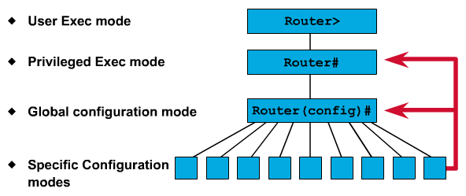
CLI command modes
Notes:
See 3.1.1

Slide 6
Configuring a router name
Router(config)# hostname Tokyo
Tokyo(config)#
Notes:
See 3.1.2

Slide 7
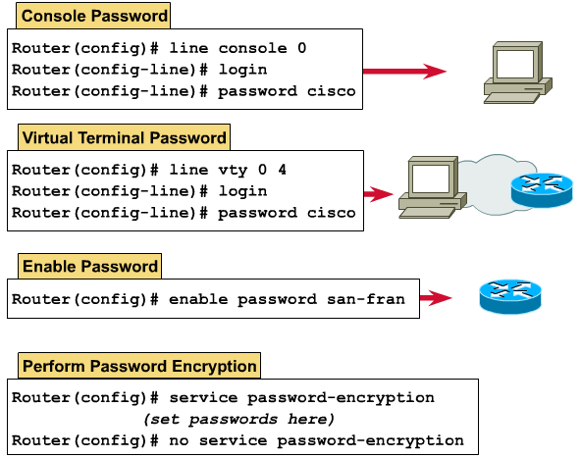
Configuring router passwords
Notes:
See 3.1.3

Slide 8
Examining the show commands
show interfaces
show controllers serial
show clock
show hosts
show users
show history
show flash
show version
show ARP
show protocol
show startup-configuration
show running-configuration
Notes:
See 3.1.4
show interfaces – Displays all the statistics for all the interfaces on the router. To view the statistics for a specific interface, enter the show interfaces command followed by the specific interface and port number. For example:
Router#show interfaces serial 0/1
show controllers serial – Displays information-specific to the interface hardware
show clock – Shows the time set in the router
show hosts – Displays a cached list of host names and addresses
show users – Displays all users who are connected to the router
show history – Displays a history of commands that have been entered
show flash – Displays information about flash memory and what IOS files are stored there
show version – Displays information about the router and the IOS that is running in RAM
show ARP – Displays the ARP table of the router
show protocol – Displays the global and interface specific status of any configured Layer 3 protocols
show startup-configuration – Displays the saved configuration located in NVRAM
show running-configuration – Displays the configuration currently running in RAM

Slide 9
Configuring a serial interface
Router# configure terminal
Router(config)# interface type slot/port
Router(config-if)# ip address <ip address> <netmask>
Router(config-if)# clock rate 64000
Router(config-if)# no shutdown
Notes:
See 3.1.5
Enter global configuration mode
Enter interface mode
Specify the interface address and subnet mask
Set clock rate if a DCE cable is connected. Skip this step if a DTE cable is connected. The available clock rates in bits per second are: 1200, 2400, 9600, 19200, 38400, 56000, 64000, 72000, 125000, 148000, 500000, 800000, 1000000, 1300000, 2000000, or 4000000.
Turn on the interface

Slide 10
Configuring an Ethernet interface
Router# configure terminal
Router(config)# interface ethernet 0/0
Router(config-if)# ip address <ip address> <netmask>
Router(config-if)# no shutdown
Notes:
See 3.1.7
Enter global configuration mode
Enter interface configuration mode
Specify the interface address and subnet mask
Enable the interface

Slide 11
Executing adds, moves, and changes
Make changes in configuration mode
Examine results
Router# show running-config
Intended results?
Remove changes
Router(config)# no …
Save changes to backup
Router# copy running-config startup-config
Router# copy running-config tftp
Router# copy running-config startup-config
Router# copy tftp running-config
Examine backup file
Router# show startup-config
Router# erase startup-config
Router# reload
Notes:
See 3.1.6

Slide 12

FINISHING THE CONFIGURATION

Slide 13
Configuring interface description
Router# configure terminal
Router(config)# interface type slot/port
Router(config-if)# description xyz
Notes:
See 3.2.2, 3.2.3

Slide 14
Configuring message-of-the-day (MOTD)
Router(config)# banner motd # You have entered a secure system, authorized access ONLY!!! #
Notes:
See 3.2.4, 3.2.5
A message-of-the-day (MOTD) banner can be displayed on all connected terminals

Slide 15
Configuring host tables
Router(config)# ip host Auckland 172.16.32.1
Router# show host
Default domain is not set
Name/address lookup uses domain service
Name server are
Host Flags Age Type Address(es)
Auckland (perm, OK) ** IP 172.16.32.1
Notes:
See 3.2.6, 3.2.7
In order to use host names to communicate with other IP devices, network devices such as routers must be able to associate the host names with IP addresses. A list of host names and their associated IP addresses is called a host table

Slide 16
Copying, editing, and pasting configurations
Router# copy tftp running-config
Host or network configuration file [host]?
IP address of remote host [255.255.255.255]? 131.108.2.155
Name of configuration file [Router-config]? tokyo.2
Configure using tokyo.2 from 131.108.2.155? [confirm] y
Booting tokyo.2 from 131.108.2.155: !! [OK-874/16000 bytes]
tokyo#
Notes:
See 3.2.8, 3.2.9
The router configuration can also be saved to a disk by capturing text in the router and saving it to the disk or hard drive. If the file needs to be copied back to the router, use the standard edit features of a terminal emulator program to paste the command file into the router.

Slide 17

Summary
The router has several modes:
  User EXEC mode
  Privileged EXEC mode
  Global configuration mode
  Other configuration modes.
The basic configuration:
  Configure hostname
  Configure password
  Configure interface
  Configure login banner
  Host name resolution
  Backup and document configuration.

Slide 18

Q&A
Notes:
_________________________________________________________________________
_________________________________________________________________________
_________________________________________________________________________
_________________________________________________________________________
_________________________________________________________________________
_________________________________________________________________________
_________________________________________________________________________
_________________________________________________________________________
_________________________________________________________________________
_________________________________________________________________________
_________________________________________________________________________
_________________________________________________________________________
_________________________________________________________________________
_________________________________________________________________________
_________________________________________________________________________
_________________________________________________________________________
_________________________________________________________________________
_________________________________________________________________________
_________________________________________________________________________

Slide 19
Enjoy the Course
Notes:
_________________________________________________________________________
_________________________________________________________________________
_________________________________________________________________________
_________________________________________________________________________
_________________________________________________________________________
_________________________________________________________________________
_________________________________________________________________________
_________________________________________________________________________
_________________________________________________________________________
_________________________________________________________________________
_________________________________________________________________________
_________________________________________________________________________
_________________________________________________________________________
_________________________________________________________________________
_________________________________________________________________________
_________________________________________________________________________
_________________________________________________________________________
_________________________________________________________________________
_________________________________________________________________________

